Slide 1
Presentation on
Presentation To:
Name:Md.Imran Hossian
Assistant Professor
Department of ICT
Comilla university
Presentation By:
Tohidul Islam
ID:11809020
Department of ICT
Comilla University

Slide 2
AM RECEIVER
AM receiver is an electronic system that receives the amplitude modulated signal and recovers the message signal.
The AM super heterodyne receiver takes the amplitude modulated wave as an input and produces the original audio signal as an output.

Slide 3
FUNCTION OF THE AM RECEIVER
Carrier frequency tuning : To select desired signal.
Filtering : To separate the desired signal from other modulated signal.
Amplification :To select the loss of signal during transmission.

Slide 4
PERFORMANCE CHARACTERISTICS OF AM RECEIVER
Selectivity :To measure the ability of the receiver and select a signal of a desired frequency & reject all other.
Sensitivity :The ability of the receiver to detect the weakest possible signal.
Fidelity :The ability of the receiver to reproduce all the range of modulating frequencies at the output sides.
Tuned radio frequency: TRF receiver is a simple logical receiver.it consists of two or three stage off RF amplifiers.

Slide 5
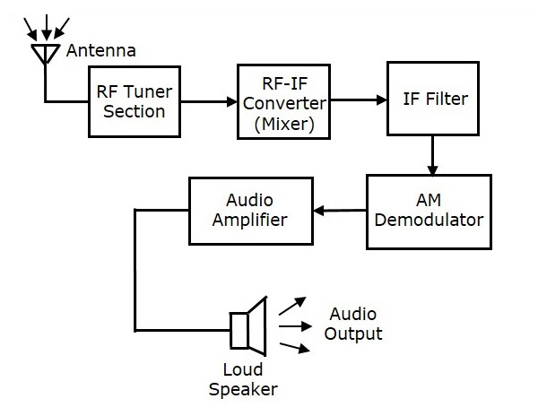
THE BLOCK DIAGRAM OF AM RECEIVER

Slide 6
RF Tuner Section
The amplitude modulated wave received by the antenna is first passed to the tuner circuit through a transformer.it selects the frequency desired by the AM receiver.it also tunes the local oscillator and the RF filter at the same time.

Slide 7
RF Mixer
The signal from the tuner output is sent to the RF-IF converter which, acts as a mixer.it has a local oscillator, which produces a constant frequency.the mixing process is done here having the received signal as one input and the local oscillator frequency as other input.

Slide 8
IF Filter
It eliminates all other unwanted frequency components present in it.the advantage of IF filter which allows only IF frequency.

Slide 9
AM Demodulator
This demodulator uses the envelop detection process to receive the modulating signal.

Slide 10
Audio Amplifier
This is the power amplifier stage which is used to amplify the detected audio signal. This signal is passed on to the loudspeaker to get the original sound signal.

Slide 11
Thanks to all.

